Slide 1
The LiPo Crew
Dataforth Battery Charger
November 10, 2020
Jonathan Ciulla - jc3598@nau.edu
Luis Camargo - lc833@nau.edu
Jace Jenkins - jcj248@nau.edu
Elray Santiago - eks226@nau.edu

Slide 2
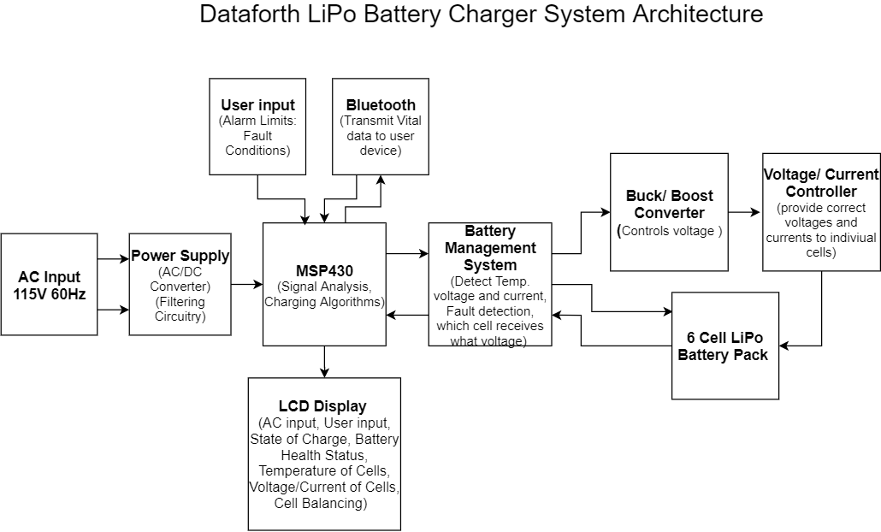
Level 1:System Architecture
Objective: Design a safe multi-cell LiPo battery charger with the support for user defined fault conditions.

Slide 3
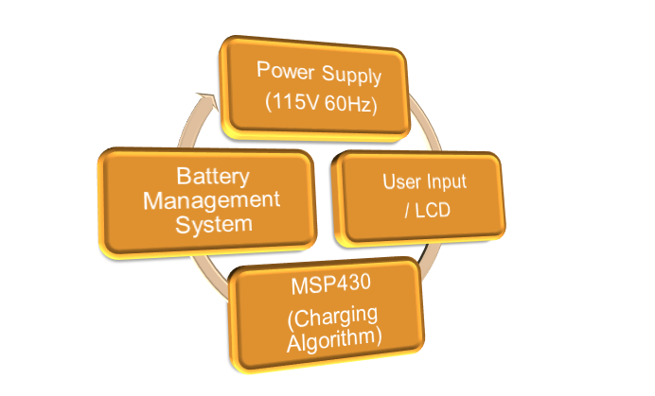
Level 2:System Overview

Slide 4
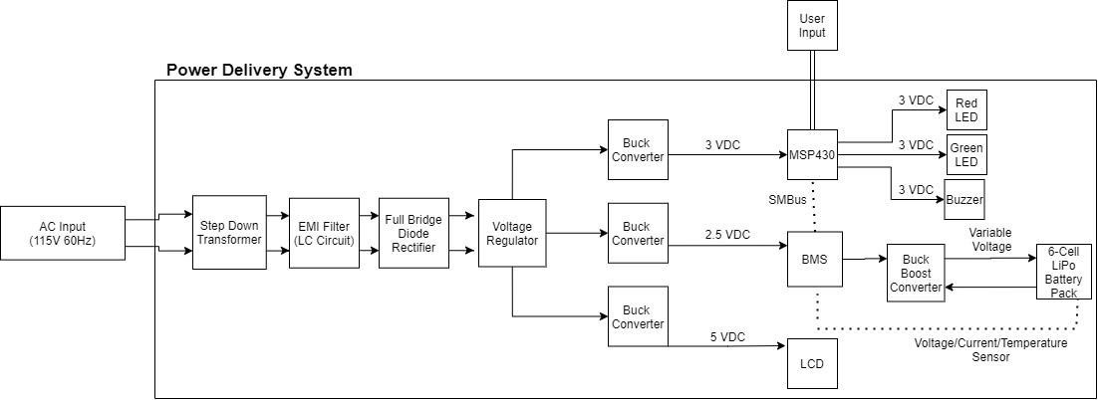
Power Delivery System

Slide 5
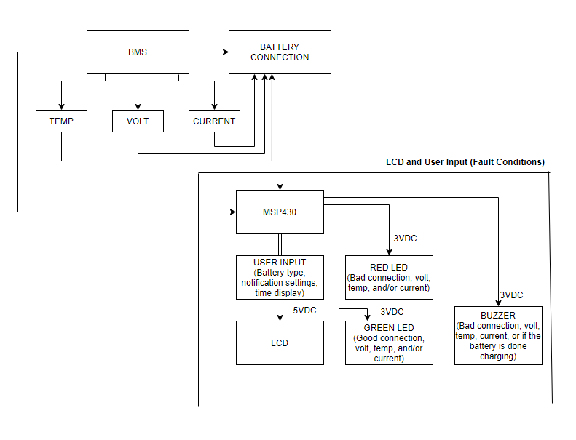
LCD and User Input (Fault Conditions)

Slide 6
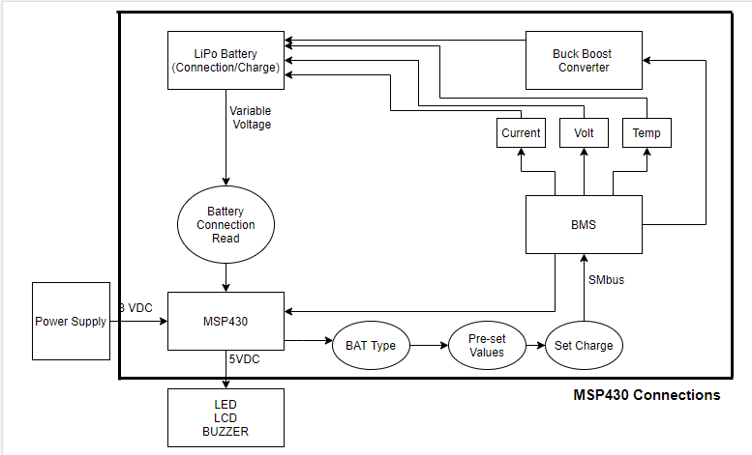
MSP430 Interconnections

Slide 7
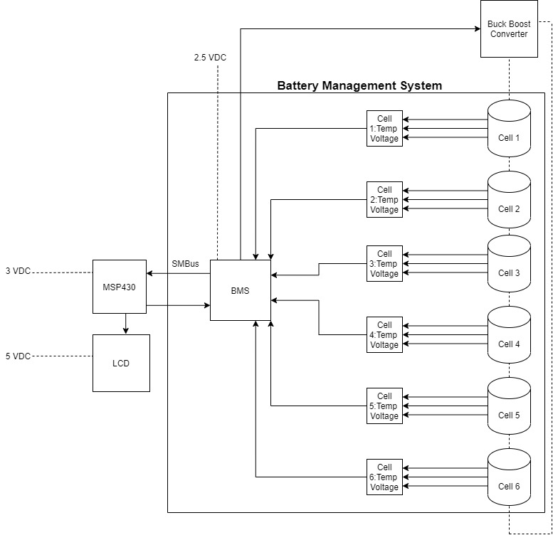
Battery Management System

Slide 8
The End

